Slide 1
The diversity of plaques in London and identifying ‘bad actors’ related to the slave trade
Work experience project, Leo ellis, July 2020
Analyzing the diversity of the people commemorated on the open plaque database in London and identifying ‘bad actors’

Slide 2
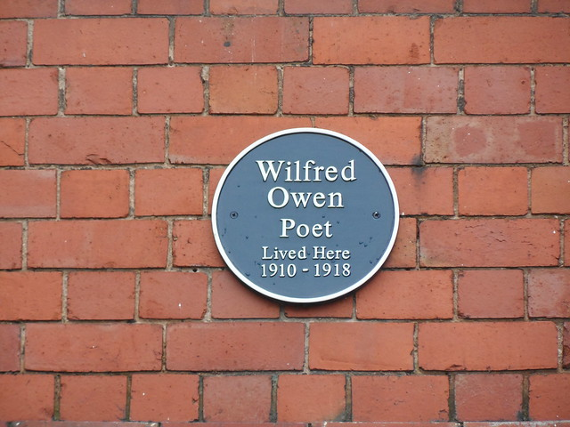
Introduction
The recent interest in the ‘Black Lives Matter’ movement has led to the scrutiny of many public statues and monuments as to whether the attributed person deserves to be kept up due to their links to the slave trade and racism. Plaques are in the public domain and thus should also undergo the same scrutiny. It is also of interest to see the ethnic diversity of those commemorated on the plaques.
The aims of the project are to:
Analyse the ethnic diversity of the plaques found in London
Identify bad actors with links to the slave trade
There are 3 readily available databases to analyse:
Open Plaques
Wikipedia
Wikidata

Slide 3
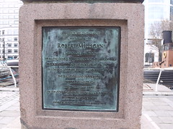
why
I personally undertook the project to learn new skills for data science and computing
Learn about workflow e.g. Github
Learn about web scrapping
Real world useful outcome
Interested in the result of the project

Slide 4
Who/what/where/when
Open plaques is an open source database documenting the historical links between people and places as recorded by commemorative plaques
This report will look at individuals commemorated by plaques found in London on the Open Plaque database. This includes 2899 plaques entries of individuals, organisations and objects. There is no specific criteria to have a plaque.
I used the pandas library with Python along with other web scrapping libraries to get more information about the individuals.
This project was done in June/July 2020 as a work experience project given to me by Open Plaques.

Slide 5
How – diversity of plaques In London
To retrieve the ethnicity of whose on the plaques, I used a qwikidata api to fetch data from wikidata.
Of the 2900 plaques, 2100 had wikidata entries/ID and only 182 or 8.6% of those had ethnicity entries.
The code runs through the entries and searches for an ethnicity field for the corresponding wikidata ID

Slide 6
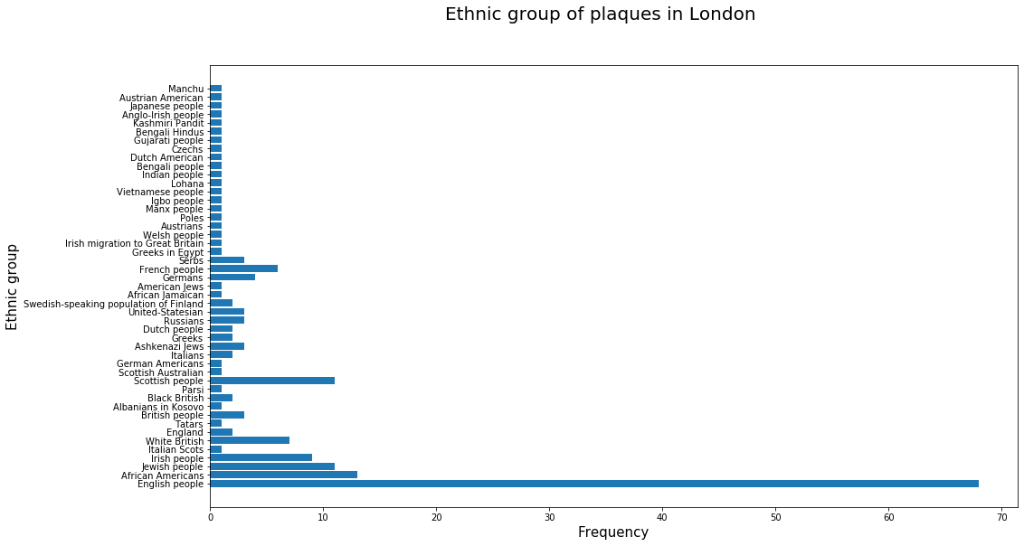

Slide 7
discussion
The low proportion of the entries containing ethnicity fields (182) mean that the chart is likely to be bias. This could be due to a correlation between the presence of an entry and the likelihood of that entry being a certain value.
The above condition necessitates that we do not draw conclusions from the chart.
The chart indicates an approximate 50% proportion of non British nationality which is well above the results of the 2011 census of ~20%

Slide 8
How – individuals with links to the slave trade
To identify bad actors I made a scoring system, using python, taking into account the following:
The presence of 10 selected words related to slavery and its converse on the Wikipedia page
Whether they appear on the slave owner list on Wikipedia or Wikidata
Whether they appear on the abolitionist list on Wikipedia
Ethnicity
Birth period
The above criteria gave both positive and negative scores (higher the score the worse). For example: slave = 10, plantation = 15, anti-slavery = -20.
Analysis of known slave owners/traders were used to help come up with this list.
Words such as ‘poet’/’author’/’composer’ appearing on the Wikipedia pages reduced the score, assuming the correlation that most poets/writers/… were against slavery.

Slide 9
results
The results from this test of the whole UK (11847 entries) finding those with the highest chance to links with slavery follow. These are the top 15 scores:
110 Robert Milligan 100 William Ewart Gladstone 75 Admiral Sir Edward Codrington RN GCB FRS 70 Simón Bolívar 70 John Gladstone FRSE 65 Quintin Hogg 65 George Whitefield 60 Richard Cobden 60 Dr James Wilson 60 William Murray, 1st Earl of Mansfield 55 John Graves Simcoe 50 Thomas Drayton 50 Sir Lt Gen Thomas Picton GCB 50 Sir Francis Drake 50 John Hancock
…
Key:
Slave trader/owned slaves
The names in Red are those which, according to Wikipedia owned or traded slaves. The other names may have other links to the slave trade.

Slide 10
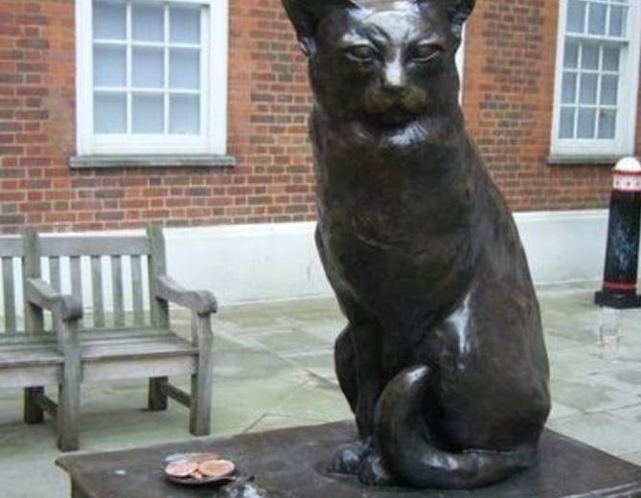
Discussion
The presence of words as a use of a filter means that the scoring system is slightly bias towards longer Wikipedia pages i.e. more well known people.
False positives have arisen when finding the entries present on the list of slave traders. For example Hodge the cat was one such result because of a mix up between names. No evidence of this cat being a slave trader has been found

Slide 11
Conclusion
In order to be useful, the number of sample with an ethnicity field must be increased
The bad actor scoring system does effectively filter down the number of possible candidates, reducing the time needed for a human to check those commemorated from 12 thousand to a number determined by a score threshold
The scoring system still needs a human to validate the choices – often the links are more complicated e.g. money/slaves inherited from family which the simple model cannot differentiate.
From this project I learn a lot of new skills from workflow to web scrapping as well as aspect of a real world problem which need to be accounted for.

Slide 12
Next steps
Investigate the use of Machine Learning techniques to identify slave traders
Find other open source databases to help these predictions
Validate, using manual checking, to quantify the scoring system.

